Slide 1
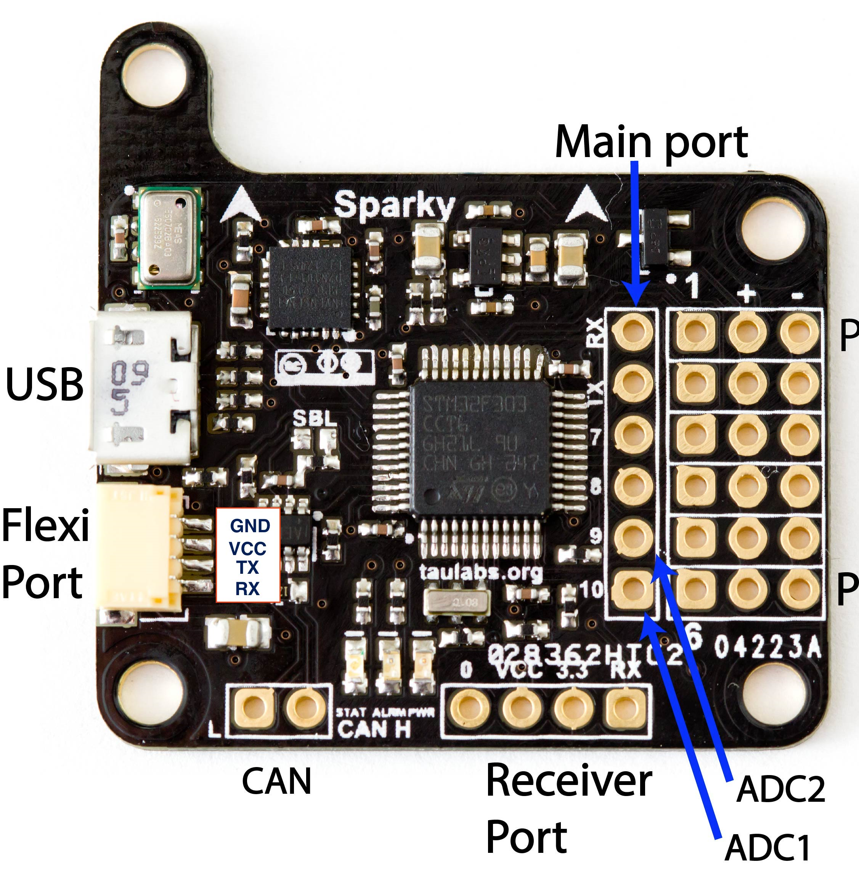
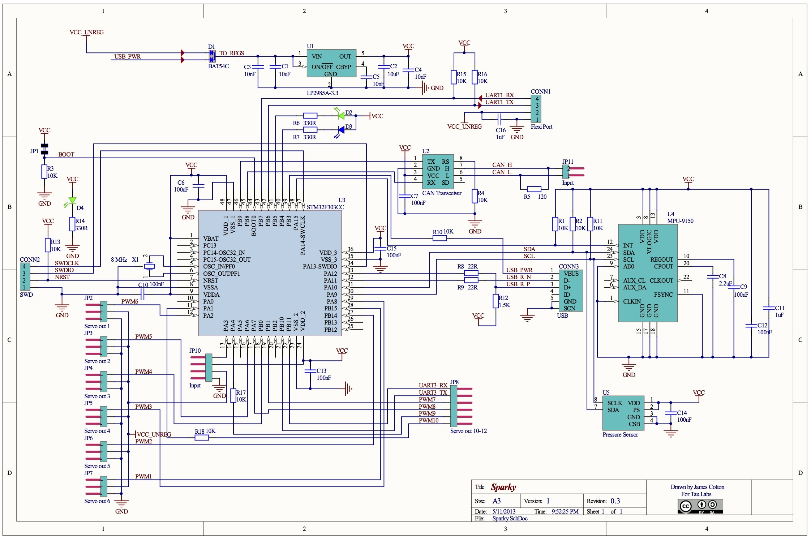
Processor: STM32F303CCT6
PB11:D31
PB10:D30
PB1:D29:A9
PA7:D27:A7
PA4:D24:A4
PA1:D21:A1
PB15:D13
PB14:D14
PA8:D12
PB0:D28:A8
PA6:D26:A6
PA2:D22:A2
PB4:D5 RED
PB5:D4 BLU
Pwr GRN
LED
GND
VCC
PB6:D3
PB7:D2
CAN
LO HI
D23:A3
PA3

Slide 2

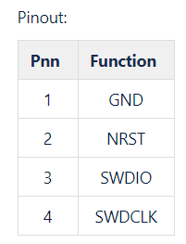
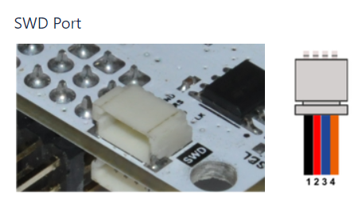

Slide 3
BACKUP MATERIAL

Slide 4


